Slide 1
PARALLAX LASER RANGE FINDER (LRF)
Mitchell Barton | ECE 578 | 10.30.12

Slide 2
Topics
Theory of Operation
Basic Operation
Initial Testing and Results
Application for MCECS Bot

Slide 3
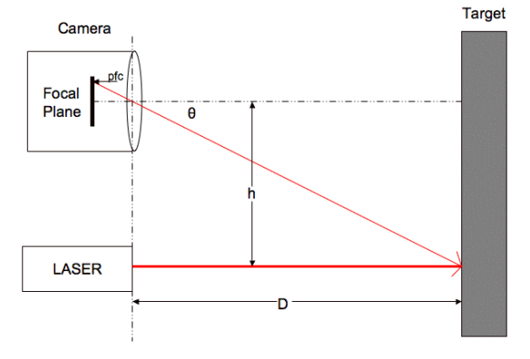
Theory of Operation
Fixed offset between camera and laser (h)
As D increases, so does the laser spot’s distance from the center of the FPA, or pixels from center (pfc).
A linear relationship between pfc and Θ, of the form y=mx+b, is derived from experimental data.
Once the laser spot is seen by the camera, Θ can be calculated and passed to the trigonometric function to determine D.

Slide 4
Theory of Operation
Once the laser spot is seen by the camera, there are additional image processing steps taken to maximize accuracy, using the Parallax propeller –Q44.
Background subtraction
Thresholding
Column sum
Blob detection
Mass/Centroid calculation

Slide 5
Basic Operation
Object detection/avoidance, navigation, rudimentary machine vision
Controlled over a serial comm interface
Command set:
R – single range measurement (4 digit decimal in mm)
B – single range measurement (4 byte binary in mm)
L – repeated range measurement
E – adjust camera for current lighting conditions
S – reset to default settings
V – print version info
H – print list of available commands
O – display coordinate, mass, and centroid info
X – calibrate camera system for range finding
G – capture and send single frame (greyscale 160p x 128p)
C – capture and send single frame (YUV422 640p x 16p)
P – capture and send single background subtracted frame (YUV422 640p x 16p)

Slide 6
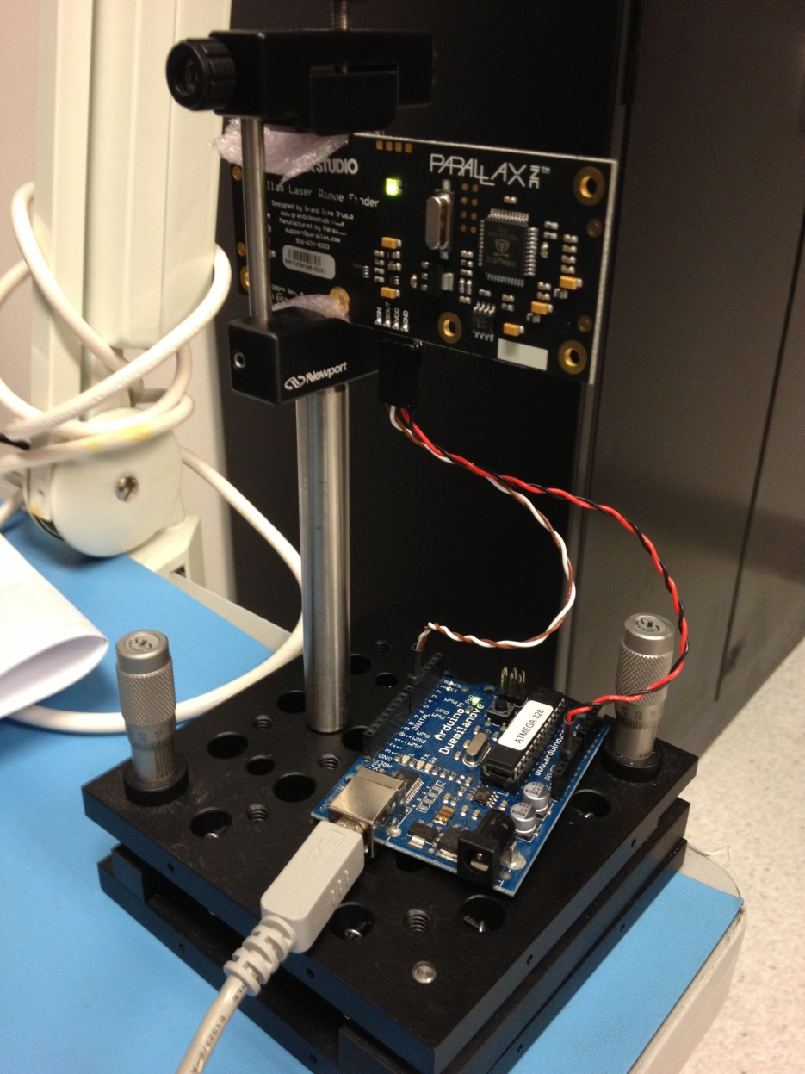
Initial Testing
Initial testing performed using an Arduino Duemilanove to provide communication between PC and LRF, as well as power for LRF.
Simple program uses Arduino software serial library to communicate over digital I/O pins, however, is unable to run at baud rates other than 9600 and is limited to a 64 byte buffer – not good.
Planned workaround is to use the Arduino Mega because it has multiple hardware serial ports which should not have these limitations.

Slide 7
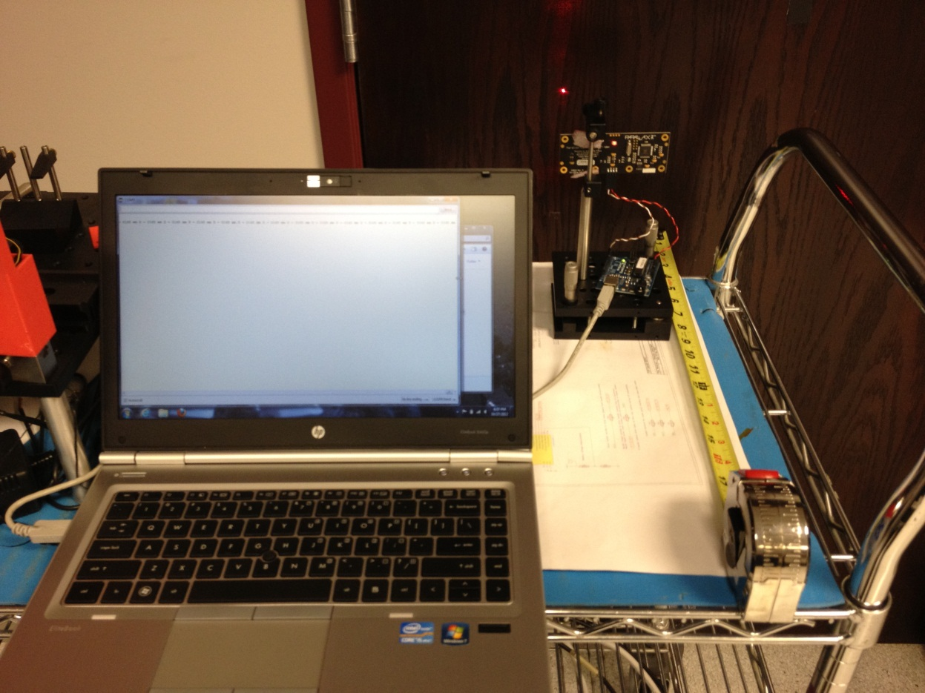
Initial Testing
The LRF is speced to provide ranges between 15-122cm with an average error of 3%, not to exceed 5%, and I wanted to test this as well as other limitations
I found that the minimum measurement was 16.5cm (6.5”)
The maximum was 242.3cm (95.4”) but this was very inaccurate. The stated maximum of 122cm was relatively accurate.
The resolution of the measurement appears to get larger as the distance gets larger, i.e. for 20cm the resolution is 0.1cm, and at 140cm it is 3.6cm.

Slide 8
Initial Testing
Actual Distance (cm) | Calculated Distance (cm) | Difference (cm) | Error (%)
20.0 cm | 20.1 cm | 0.1 cm | 0.50
30.0 cm | 30.0 cm | 0 cm | 0
40.0 cm | 40.1 cm | 0.1 cm | 0.50
50.0 cm | 49.8 cm | -0.2 cm | 0.40
60.0 cm | 59.1 cm | -0.9 cm | 1.5
I took several measurements at each of the 5 positions shown above, and there was very good repeatability.
This was for a wooden door, but when I tried to measure this on a glossy white door the camera had to adjust before getting good repeatability.
Also moving during the acquisition causes more errors and inaccuracy, primarily if the ‘laser on’ frame is much different than the ‘laser off’ frame. This means that the robot will need to limit motion during frame acquisition.

Slide 9
Initial Testing
The measured distance did not change as it should have with angle, i.e. there is an insensitivity to angular offset, and it is less accurate in azimuth, that is, the plane in which the camera and laser are the same distance from the floor.
In azimuth, I measured the same distance, 59.1cm, through an angle of 13.3°, after which the measurement jumped to 59.8cm. In elevation the angle was only 1.64° before the measurement again jumped to 59.8cm.
This leads me to believe that the resolution is worse for angular variations in both elevation and azimuth, while accuracy degrades significantly more for angular variations in azimuth, which is to say when the camera and laser are not equidistant to the target. This may require more testing to understand fully.
x = 59.8cm
D = 60cm
x = 59.1cm
Θ_{x} = 13.3°
x = 59.8cm

Slide 10
Application for MCECS Bot
This will be most useful for object detection, but can also be used for more precise navigation at small distances (17-122cm).
There is the ability to use the camera as a blob detector as well.
Implementing a Kalman filter, using the sonar sensors as well, for position estimation would be an ideal final solution for the MCECS bot navigation.
I believe that we will need to implement a task management system to successfully implement all of the control and sense tasks efficiently on the arduino mega.
Fixed position or multi-position, single read or multi-read?

Slide 11
Questions or Comments??? (no spears please)

